Slide 1


Department of Computer Science and Engineering
Detecting Humans in Search and Rescue Operations Based on EfficientDet Architecture
Team Members Name / Register Number
Aakash A [211419104001]
Arun Kumar G [211419104023]
Benson Joseph R [211419104040]
Guide Name & Designation
Dr.N.PUGHAZENDI,M.E.,Ph.D.,
Coordinator Name & Designation
Dr.N.PUGHAZENDI,M.E.,Ph.D.,

Slide 2
Introduction
Detecting humans in aerial images remains a tedious task for the application based on Search And Rescue operation[SAR].
The prime goal of SAR is to detect and assist people who were met accident in mountain or other hazardous environment.
For detecting people in SAR application, aerial image of mountain landscapes is utilized.
In this model, we propose a novel method for the detection of humans in aerial images based on Deep learning architecture.

Slide 3
Objectives
The objective of using YOLO5 and ensemble learning for human detection in search and rescue operations with input video is to develop an accurate and efficient system that can quickly detect human presence in various environments, including difficult-to-reach or hazardous areas.
To improve the performance of the system, ensemble learning will be employed. This involves combining multiple YOLO5 models trained on different subsets of the data to produce a final model with higher accuracy and robustness.
The input video will be processed in real-time by the YOLO5 ensemble model to detect human presence. The system will output the location of detected humans on the video and alert the rescue team to their presence, enabling them to respond quickly and efficiently.
The main objective of this system is to improve the efficiency and effectiveness of search and rescue operations by quickly detecting human presence in hazardous environments, thus saving lives and reducing the risk to rescue teams.

Slide 4
Literature Review
S.NO | TITLE | AUTHOR | YEAR | PUBLISHERS
1. | Deep Learning for Object Detection and Segmentation in Videos. | Athina Ilioudi, Azita Dabiri, Ben J. Wolf, Bart De Schutter | April 4, 2022 | IEEE
2. | Detection of humans in drone images for search and rescue operations. | N. M. K. Dousai and S. Loncaric | January, 2021 | ACT Digital Library Board
3. | Search and rescue operation using UAVs. | Martinez-Alpiste, G. Golcarenarenji, Q. Wang | September, 2021 | ResearchGate

Slide 5
S.no | TITLE | AUTHOR | YEAR | PUBLISHERS
4 | EfficientDet: Scalable and Efficient Object Detection | Mingxing Tan Ruoming Pang Quoc V. Le | June, 2020 | Cornell University
5 | YOLOv4: Optimal Speed and Accuracy of Object Detection | A.Bochkovskiy, C.-Y. Wang, and H.-Y. Mark Liao, | 2020 | ResearchGate
6 | Delving into high quality object detection | Zhaowei Cai and Nuno Vasconcelos | 2018 | Cornell University
7 | Automatic person detection in search and rescue operations using deep CNN detectors. | S. Sambolek, M. Ivasic-Kos | October, 2017 | IEEE

Slide 6
Problem Statement
The task at hand is to develop an effective system for the detection of humans in search and rescue operations, using YOLOv5 and ensemble learning. The system must be capable of accurately identifying humans in real-time, in a range of environmental conditions and situations.
Search and rescue operations are often carried out in challenging conditions, where time is of the essence and every second counts. The use of machine learning models can significantly aid in the detection of humans, allowing rescue teams to quickly locate and extract individuals in need of assistance.
The system must be trained on a diverse set of images and videos, including a variety of environmental conditions, camera angles, and distances from the target. Additionally, the system must be optimized for speed and accuracy, with minimal false positives and false negatives.
The ultimate goal is to create a reliable and effective system that can aid search and rescue teams in locating and extracting individuals in need of assistance, potentially saving life's in emergency situations.

Slide 7
Existing System
Object detection is one of the most researched areas in computer vision.
Object detection refers to finding different types of objects in the scene such as peoples, cars, animals or other existing objects present in the scene.
Detecting objects in aerial imagery is still considered a difficult task.
Object detection in aerial images depends on several factors such as low visibility due to varying altitudes, the object-of-interest, variations in pose and scale, camouflaged environment with rocks and trees, and high-resolution aerial images.
Due to imaging from high altitudes, only 0.1 to 0.2 percentage of the image represents humans.

Slide 8
Proposed System
In the proposed system, Data augmentation step is applied on dataset after preprocessing to generate well labeled training database.
Second, train deep learning architecture with newly created dataset to identify human in aerial image
We propose the implementation of EffcientDET architecture and ensemble learning based on Bidirectional Feature Pyramid Network (Bi-FPN) and Fully Connected Feature Pyramid Network (FC-FPN).

Slide 9
Development Environment
HARDWARE REQUIREMENTS
Hard Disk : 500GB and Above
RAM : 8GB and Above
Processor : I5 and Above
GPU
SOFTWARE REQUIREMENTS
Operating System : Windows 10 (64 bit)
Software : Python
Tools : Anaconda

Slide 10
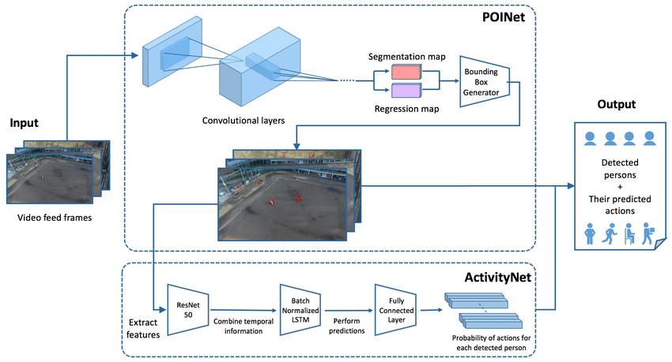
System Architecture

Slide 11
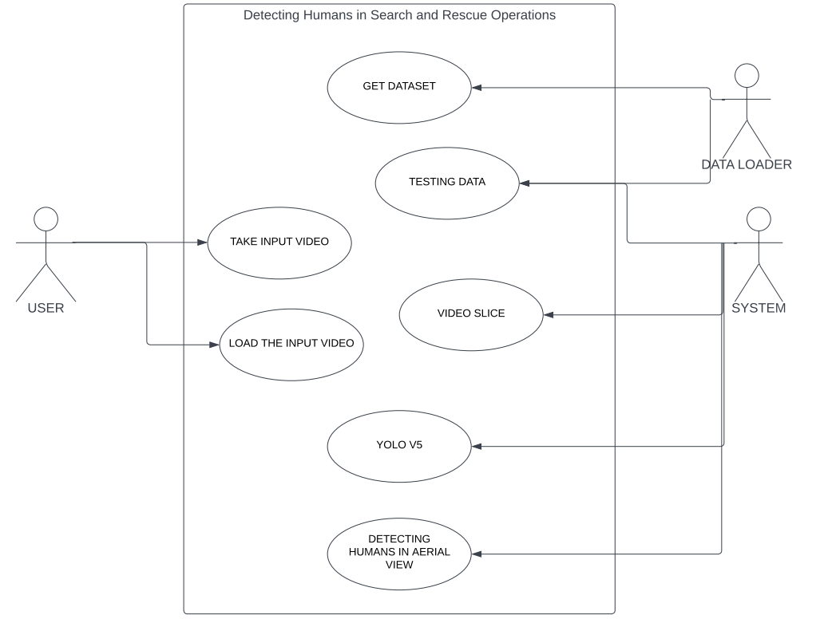
UML/ER DIAGRAMS Use Case Diagram

Slide 12
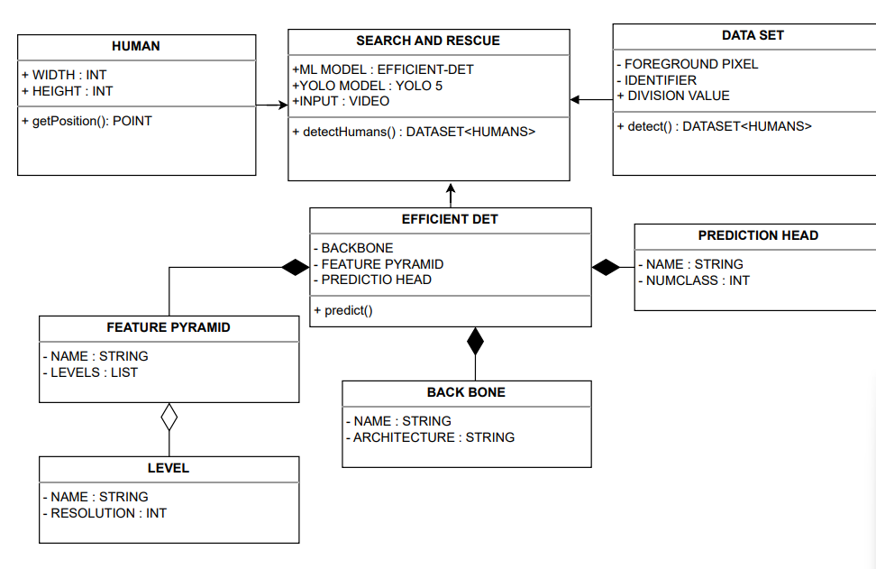
Class Diagram

Slide 13
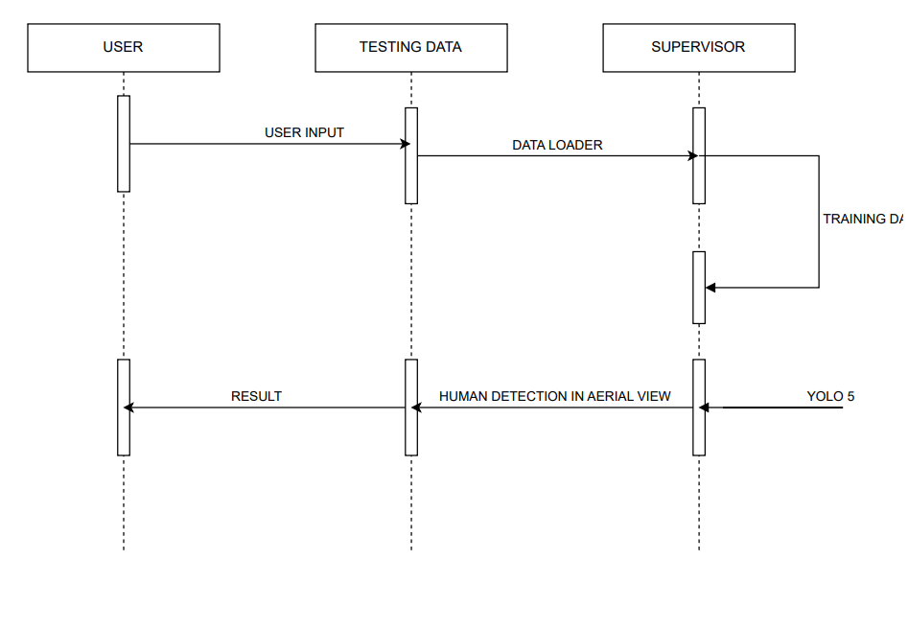
Sequence Diagram

Slide 14
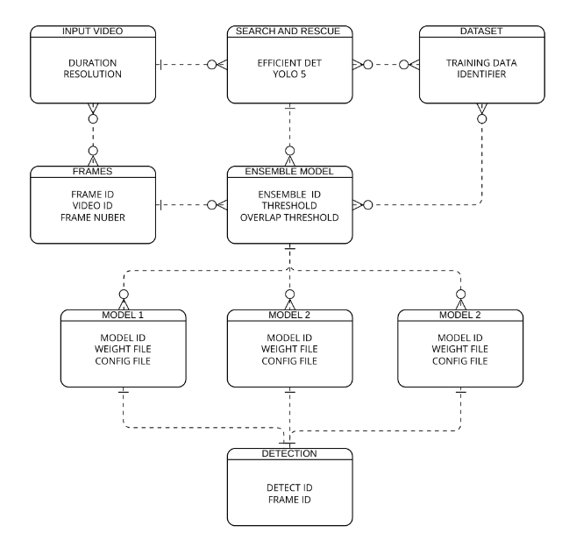
ER Diagram

Slide 15
Module Description
List Of Modules
Dataset Collection
Preprocessing
Algorithm Implementation
Prediction

Slide 16
MODULE EXPLANATION:
1. DATASET COLLECTION
There are several open-sourced datasets available for ground to-ground images but to find a well-annotated aerial dataset for the suitable application is difficult. However, a few aerial image datasets have recently been captured in diverse scenarios, e.g., for crowded places, playgrounds, mountains, urban and non-urban areas.
Finding an authentic and reliable aerial dataset for search and rescue operations is considered crucial as the testing results are dependent on the selection of the training dataset. After the PASCAL VOC dataset has been publicly open-sourced, there have been many challenging and well labelled open-sourced object detection datasets available from different researchers and organizations.

Slide 17
2. PREPROCESSING
Due to the drawback of high-resolution aerial images, most published research on aerial detection using deep-learning methods lacks accuracy and computation time. Even for our research and selection of the aerial dataset section, we have found that the HERIDAL database has an image pixel size of 4000 × 3000.
Deep-learning models will require a large amount of RAM for the Graphical Processing Unit(GPU) and enormous amount of time to train 1500 well-labelled training database. To overcome this drawback, we have proposed a pre processing step, where we have proposed two different scenarios for the generation of new HERIDAL database into various image sizes such as 512,640, and 1024.
At scenario, we will consider and include all existing humans in the defined picture window varying from 512 to 1024 image resolution. In the second scenario, when there are single or more humans for the defined image window we will generate them as two or more images. One of the main reason to include this pre-processing step is to decrease the HERIDAL dataset image resolution by neglecting the image area where there is no presence of humans.

Slide 18
3. ALGORITHM IMPLEMENTATION :
We propose the implementation of EfficientDET architecture and ensemble learning based on Bidirectional Feature Pyramid Network (Bi-FPN) and Fully Connected Feature Pyramid Network (FC-FPN).
One of the main idea of selecting and implementing the EfficientDET architecture for our research is due to its better accuracy compared to FasterRCNN, YOLOv3 and the other existing object detectors. From the EfficientDET we can observe that the method can overcome the drawback of the multi-scale feature fusion problem.
EfficientDET can be explained into two steps: imagenet-based pre-trained EfficientNETs and repeated feature extraction networks. It is difficult to scale the network uniformly based on depth, width, and resolution for most other well-known object detectors.
We propose to implement ensemble learning based on BiFPN and FC-FPN. One of the main reasons to choose Bi-FPN and FC-FPN over the other existing feature fusion models is due to better performance and accuracy of the modules.

Slide 19
4. PREDICTION :
In most object detector models, mAP (mean Average Precision) is the popular metric to evaluate the results.
The mAP computes the score by comparing the ground-truth bounding box to the detected bounding box.
The higher the score, the better the model detection. The mAP is the AP mean, it is computed for each class and averaged to obtain the mAP. In SAR operations, we must detect only humans as a class.
As mentioned in the equations , average precision computes the precision value for recall values ranging from 0 to 1.
The precision score is a measure of how accurate your predictions are i.e., the percentage of predictions are exactly correct, whereas recall evaluates how well you can locate all of the models positives.

Slide 20
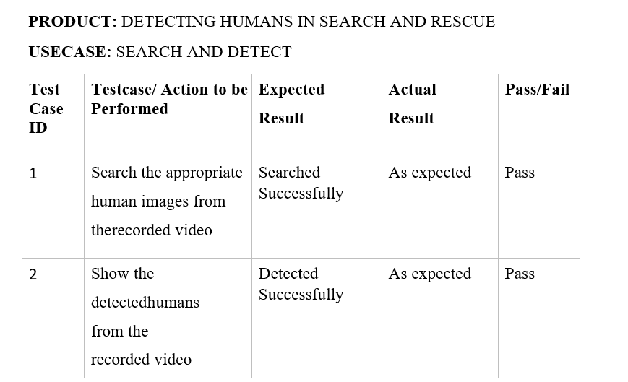
Testing

Slide 21
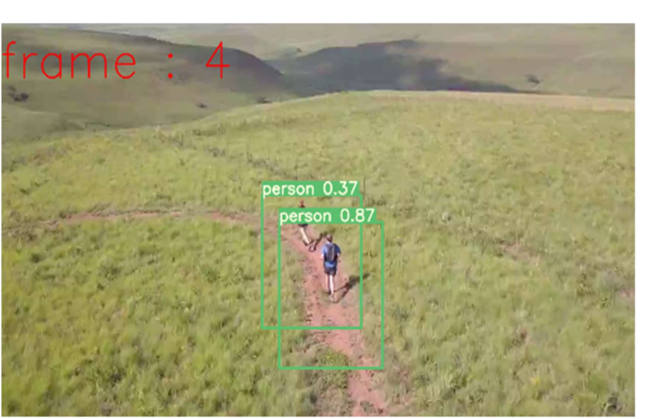
Screenshots

Slide 22
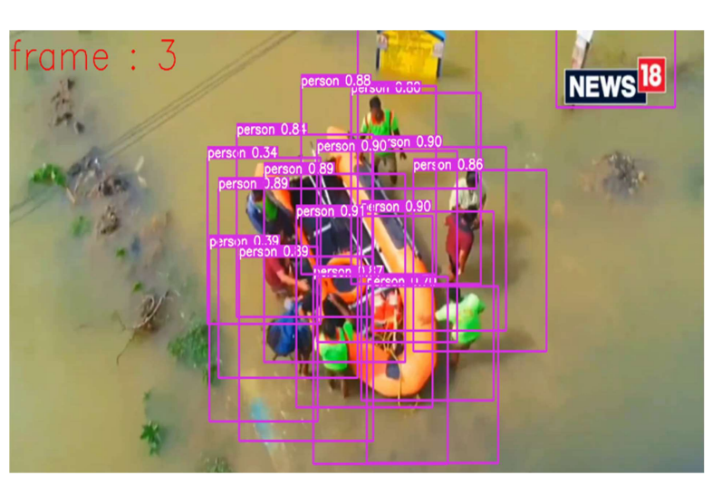

Slide 23
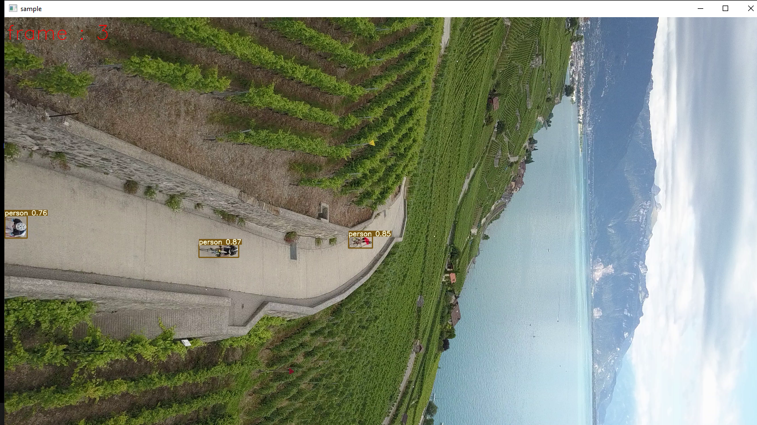

Slide 24
Conclusion
We can save many individuals who are involved in mountain accidents by detecting humans in SAR missions. We can minimize the cost and time involved in traditional SAR operations by using drones.
We have examined the state-of-the-art person detectors implemented on the HERIDAL dataset and proposed an ensemble learning-based method for detecting humans for our research.
Following the preprocessing step, we proposed an ensemble learning method in which we adopted EfficientDET architecture with BiFPN as one branch and EfficientDET architecture with FC-FPN as the other.
Both the steps are concatenated with the best features to follow up with the class and bounding box networks to detect humans in SAR operations. All of the experimental results are discussed and presented in the paper with various figures and plotted tables.
The proposed model in the paper has implemented on the HERIDAL dataset, which is specifically created for SAR operations.

Slide 25
Future Enhancement
There are several potential future enhancements to human search and rescue operations. Here are a few examples:
Use of Drones: Drones can be used for search and rescue operations in hard-to-reach areas. Drones equipped with cameras and other sensors can quickly cover large areas and provide real-time data to rescuers on the ground. They can also be equipped with thermal imaging cameras to detect body heat and help locate missing persons in the dark.
Augmented Reality: Augmented reality (AR) can be used to enhance search and rescue operations by overlaying digital information on the real world. Rescuers can wear AR glasses or use a handheld device to view digital maps, GPS coordinates, and other important data. This can help them navigate to the location of the missing person more quickly and accurately.
Robotics: Robots can be used in search and rescue operations to access areas that are too dangerous for humans. For example, robots can be used to explore collapsed buildings, mines, and other hazardous areas. They can also be used to deliver supplies and equipment to rescuers on the ground.

Slide 26
References
[1] X. Wang, ``Deep learning in object recognition, detection, and segmentation,‘’ Found. Trends Signal Process., vol. 8, no. 4, pp. 217_382, 2016.
[2] Z. Sun, G. Bebis, and R. Miller, ``On-road vehicle detection: A review,'' IEEE Trans. Pattern Anal. Mach. Intel., vol. 28, no. 5, pp. 694_711,May 2006.
[3] P. Dollar, C. Wojek, B. Schiele, and P. Perona, ``Pedestrian detection: An evaluation of the state of the art,'' IEEE Trans. Pattern Anal. Mach. Intell., vol. 34, no. 4, pp. 743_761, Apr. 2012.
[4]I.Martinez-Alpiste,G.Golcarenarenji,Q.Wang,andJ.M.Alcaraz-Calero, ‘‘Search and rescue operation using UAVs: A case study,’’ Expert Syst. Appl., vol. 178, Sep. 2021, Art. no. 114937.
[5] M. Kampouraki, G. A. Wood, and T. R. Brewer, ‘‘Opportunities and limitations of object based image analysis for detecting urban impervious and vegetated surfaces using truecolour aerial photography,’’ in ObjectBased Image Analysis. Berlin, Germany: Springer, 2008, pp. 555–569.

Slide 27
[6] M. Paul, S. M. E. Haque, and S. Chakraborty, ``Human detection in surveillance videos and its applications review,'' EURASIP J. Adv. Signal Process., vol. 2013, no. 1, pp. 1_16, Dec. 2013.
[7] G.-S. Xia, X. Bai, J. Ding, Z. Zhu, S. Belongie, J. Luo, M. Datcu, M. Pelillo, and L. Zhang, ``DOTA: A large-scale dataset for object detection in aerial images,'' in Proc. IEEE/CVF Conf. Comput. Vis. Pattern Recognit., Jun. 2018, pp. 3974_3983.
[8] H. Majesty's, ``Inspectorate of constabulary and _re and rescue services. Planes, drones and helicopters: An independent study of police air support,'' HMICFRS, London, U.K., 2017, pp. 1_97.
[9] P. Rudol and P. Doherty, ‘‘Human body detection and geolocalization for UAV search and rescue missions using color and thermal imagery,’’ in Proc. IEEE Aerosp. Conf., Mar. 2008, pp. 1–8.
[10] C. Burke, P. R. McWhirter, J. Veitch-Michaelis, O. McAree, H. A. G. Pointon, S. Wich, and S. Longmore, ‘‘Requirements and limitations of thermal drones for effective search and rescue in marine and coastal areas,’’ Drones, vol. 3, no. 4, p. 78, Oct. 2019.

Slide 28
THANK YOU!

